Slide 1


SUMMER INTERNSHIP 2025
Sameer Modi
23410030
Btech 2nd
Geological Technology
sameer_m@es.iitr.ac.in

Slide 2
Objective 1:
To automate geological facies classification from well log data using machine learning algorithms.

Slide 3
Introduction:
A facies is a body of rock or sediment that is distinguished from adjacent units by a unique combination of physical, chemical, and biological characteristics. These features reflect the specific conditions under which the rock was formed and help geologists interpret past environments.
Key Characteristics:
Lithology (grain size, composition, color, texture)
Fossils (biological content)
Sedimentary structures (e.g., ripples, cross-bedding)
Well log responses (gamma ray, resistivity, etc.)
Seismic Properties

Slide 4
Well Locations
Shale Sampling Locations
Raniganj Sub basin (West Bengal):
Well 1
Well 2
Jharia Sub basin ( Jharkhand):
Well 3
Well 4

Slide 5
Materials & Methods
Data and Features
The project utilizes a dataset derived from well logs. The dataset includes logs under the following headers :
Depth (DEPT[M])
Caliper (CALIPER[MM])
Density (DEN[GM/CC])
Resistivity (RES(64N), RES[OHM])
Spontaneous Potential (SP[MV])
Gamma Ray (GAM[API])
Lithology Description
Formation and Lithology

Slide 6
Materials & Methods
Uniquely Identified Facies
Sandstone - SST
Shaly Sandstone - ss
Dark Grey Shale - dgs
Gray Shale - gs
Carb Shale
coal

Slide 7
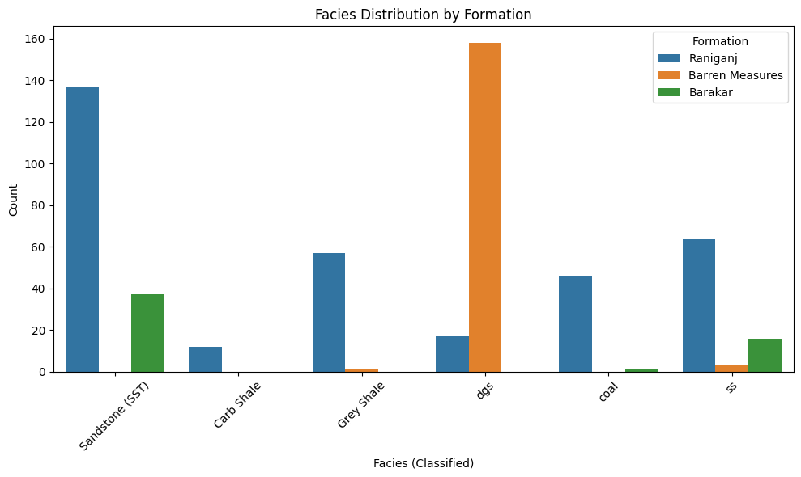
WELL-1 Facies Distribution by Formation

Slide 8
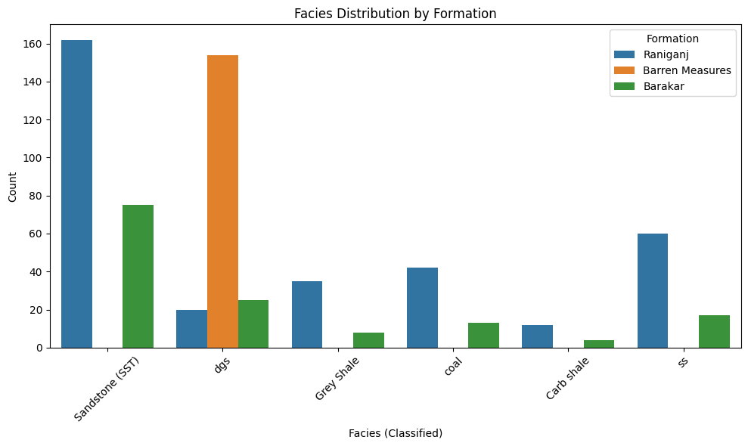
WELL-2 Facies Distribution by Formation

Slide 9
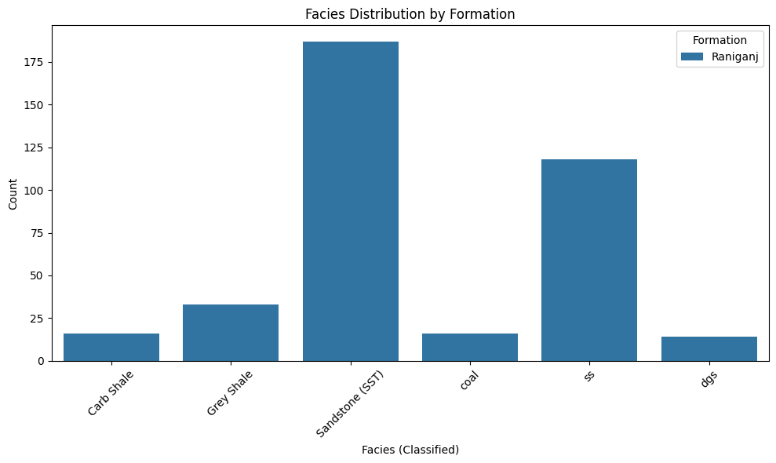
WELL-3 Facies Distribution by Formation

Slide 10
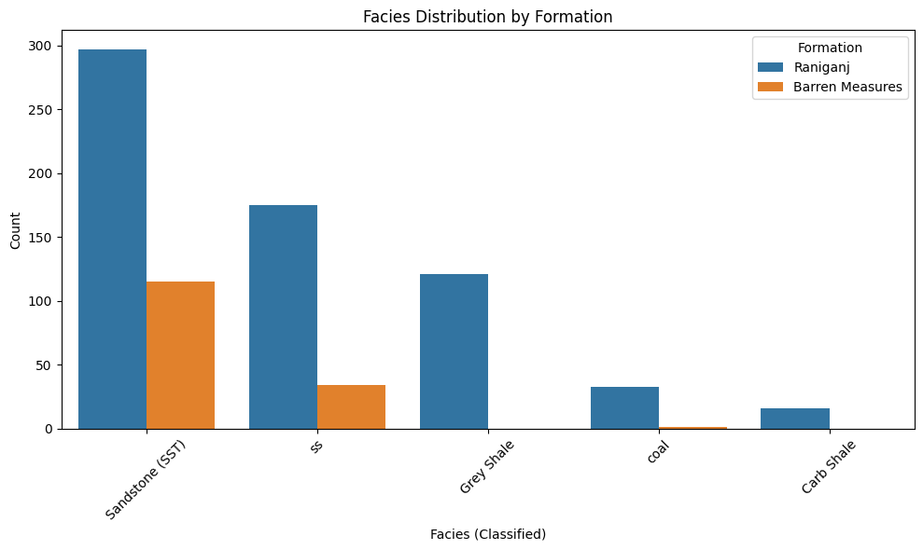
WELL-4 Facies Distribution by Formation

Slide 11
Modelling Approach
Dataset
Data Preparation
Train Test Split
DEN[G/CM], RES(64N),
SP[MV], GAM[API]
Target : Facies
Reclassification of 1000+ lithology into 6 facies
Removing NULL values
Min Max Scaling for numeric columns
80 % - Training
20 % - Test
Model Evaluation
Fine Tunning
Model Training
Accuracy, Precision, Recall
GridSearchCV
Logistic Regression
XGBoost
Random Forest
KNN

Slide 12
MODELS:
Logistic Regression
Support Vector Classifier(SVC)
K-Nearest Neighbours(KNN)
Random Forest Classifier
XGBoost Classifier

Slide 13
LOGISTIC REGRESSION
Type: Linear model for classification
Working: Calculates a weighted sum of these inputs, then applies the logistic (sigmoid) function to estimate the probability that a sample belongs to each facies.The facies with the highest probability is chosen as the predicted class.
Why used: Simple, interpretable, and effective when the data is linearly separable.

Slide 14
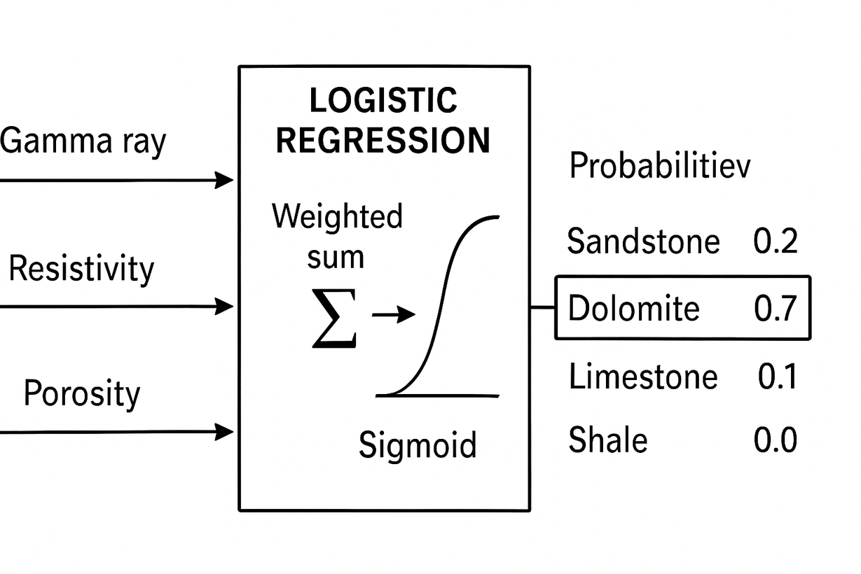
LOGISTIC REGRESSION
Probabilities
Gamma Ray
Sandstone
0.2
carb shale
0.6
Resistivity
gray shale
0.05
coal
0.07
SP
dgs
0.08

Slide 15
SUPPORT VECTOR CLASSIFIER(SVC)
Type: Classification algorithm (can be linear or non-linear)
Working: Finds a line or surface (called a hyperplane) that best separates different classes. It uses only the closest points (support vectors) to decide this boundary.
Why used: Works well when classes are clearly separated. Useful for small to medium datasets, especially with many features.

Slide 16
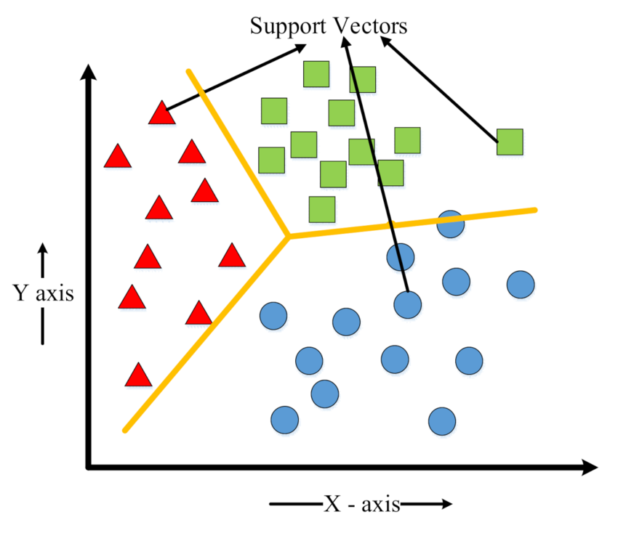
SUPPORT VECTOR CLASSIFIER(SVC)

Slide 17
K-NEAREST NEIGHBOURS(KNN)
Type: Instance-based classification algorithm
Working: Classifies a new point based on the majority class of its K nearest neighbors in the training data. It uses distance (like Euclidean) to find these neighbors.
Why used: Simple and easy to implement. Works well when decision boundaries are irregular or non-linear.

Slide 18
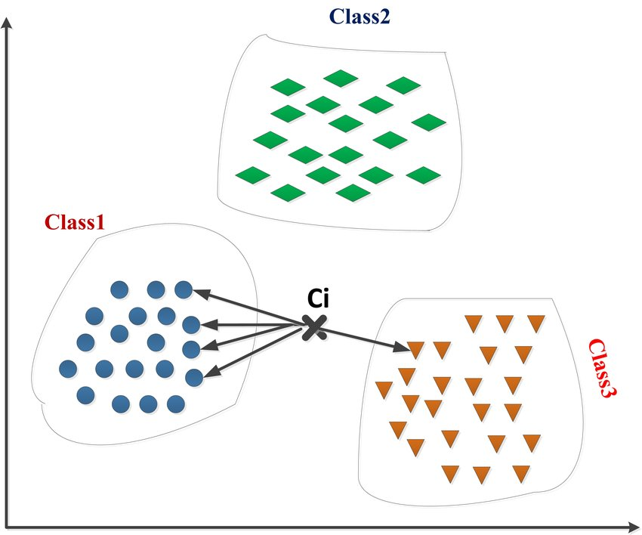
K-NEAREST NEIGHBOURS(KNN)

Slide 19
RANDOM FOREST
Type: Ensemble model (bagging of decision trees)
Working: Builds multiple decision trees and combines their outputs to improve accuracy and reduce overfitting.
Why used: Robust to noise, handles non-linear relationships, and works well with high-dimensional data.

Slide 20
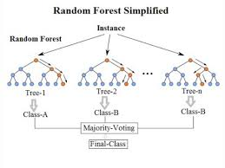
RANDOM FOREST

Slide 21
RANDOM FOREST
Base Learners
S1
Decision Tree
Row Sampling
S2
Decision Tree
Combine Results
Final Prediction
Dataset
...
Sn
Decision Tree

Slide 22
XGBOOST
Type: Ensemble model (boosting)
Working: Builds decision trees sequentially, where each new tree corrects errors from the previous ones.
Why used: High performance, handles missing values, regularization reduces overfitting, often gives state-of-the-art results.

Slide 23
RESULTS
Facies | Model | Precision | Recall | F1 Score
Dark Grey Shale (dgs) | Random Forest | 0.94 | 0.85 | 0.89
 | XGBoost | 0.86 | 0.82 | 0.84
 | SVC | 0.88 | 0.78 | 0.83
 | Logistic Regression | 0.78 | 0.82 | 0.80
 | KNN | 0.78 | 0.76 | 0.77

Slide 24
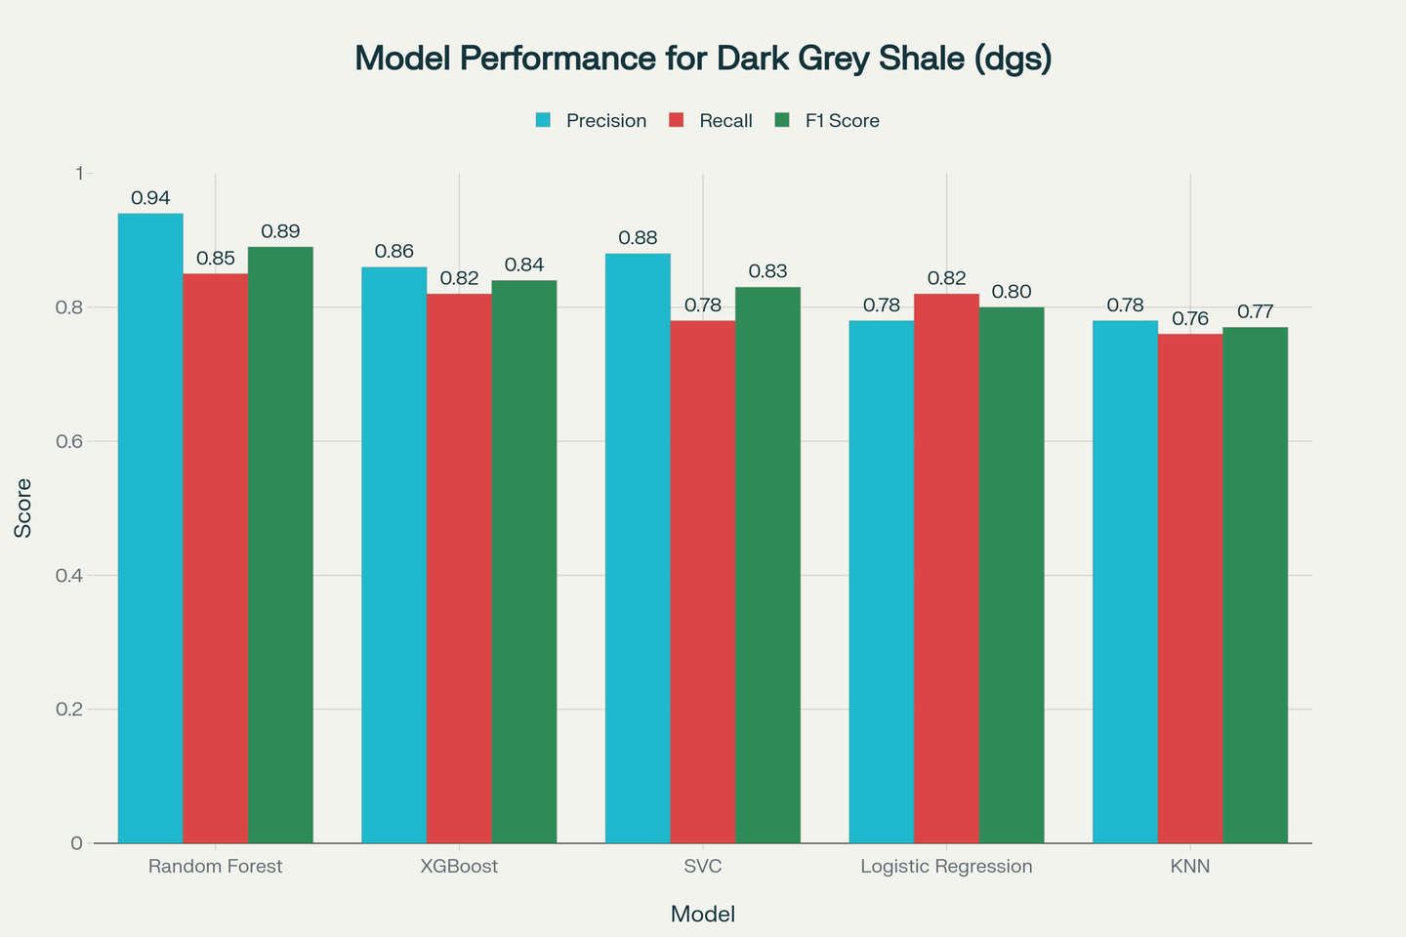
RESULTS

Slide 25
RESULTS
Facies | Model | Precision | Recall | F1 Score
SandStone (SST) | Logistic Regression | 0.74 | 0.52 | 0.61
 | XGBoost | 0.61 | 0.53 | 0.57
 | Random Forest | 0.61 | 0.49 | 0.55
 | KNN | 0.59 | 0.46 | 0.52
 | SVC | 0.66 | 0.39 | 0.49

Slide 26
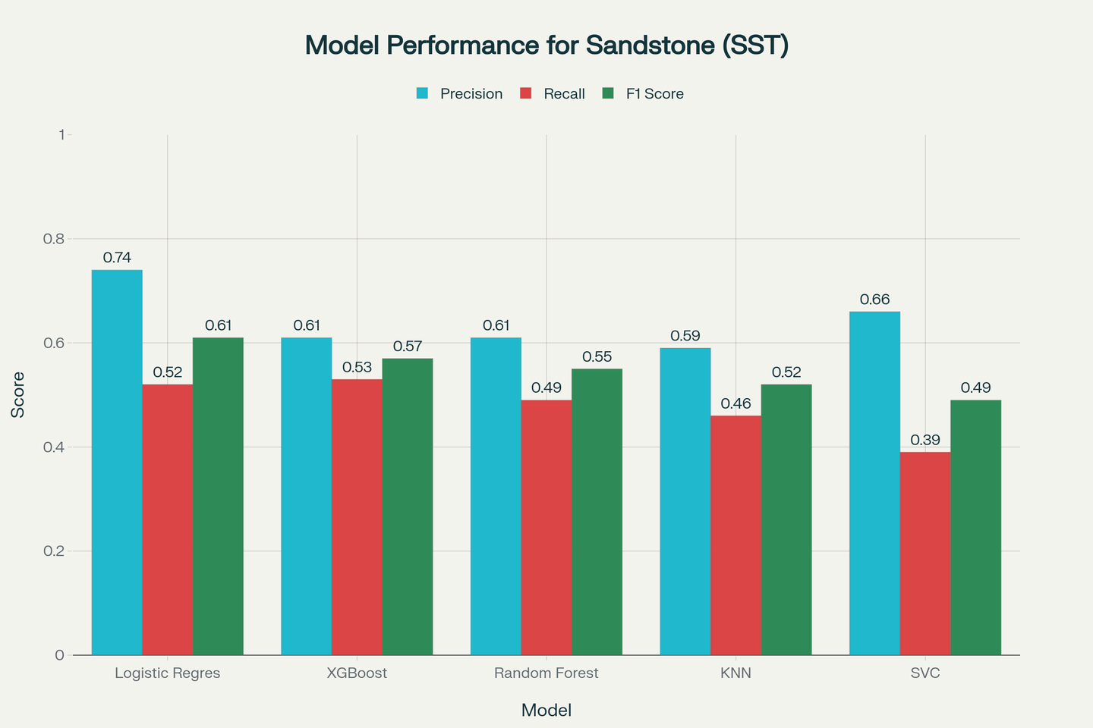
RESULTS

Slide 27
RESULTS
Facies | Model | Precision | Recall | F1 Score
Coal | Logistic Regression | 0.36 | 0.50 | 0.41
 | Random Forest | 0.33 | 0.46 | 0.39
 | SVC | 0.37 | 0.42 | 0.39
 | XGBoost | 0.34 | 0.42 | 0.38
 | KNN | 0.20 | 0.29 | 0.24

Slide 28
RESULTS
Facies | Model | Precision | Recall | F1 Score
Shaly Sandstone (ss) | SVC | 0.40 | 0.68 | 0.50
 | Logistic Regression | 0.46 | 0.52 | 0.49
 | XGBoost | 0.40 | 0.52 | 0.45
 | Random Forest | 0.37 | 0.52 | 0.43
 | KNN | 0.34 | 0.38 | 0.36

Slide 29
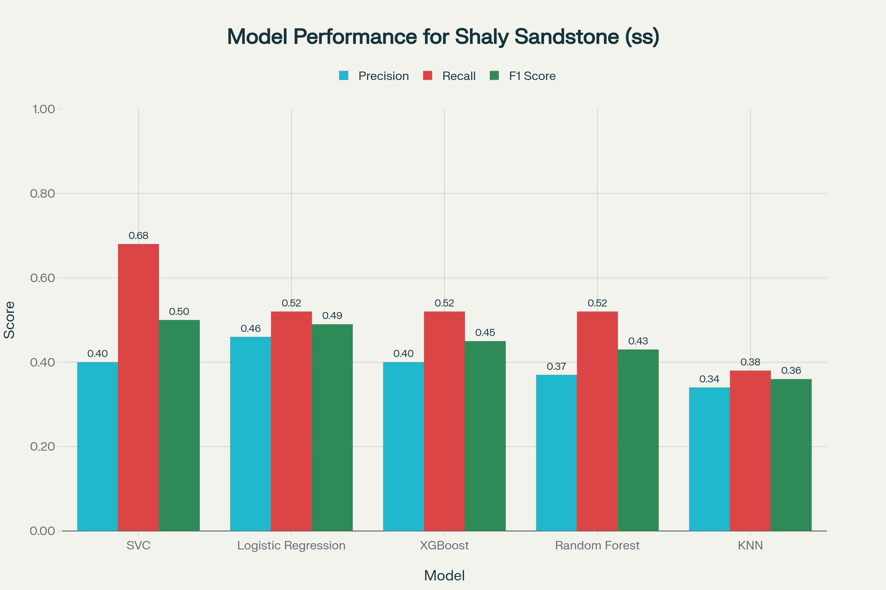
RESULTS

Slide 30
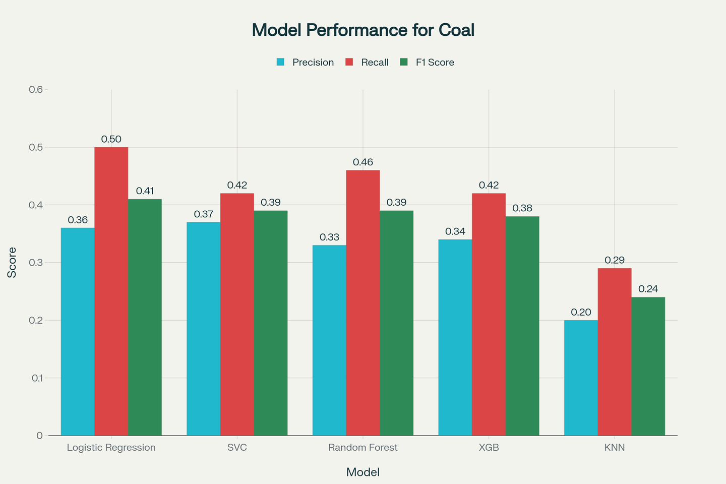
RESULTS

Slide 31
RESULTS
Facies | Model | Precision | Recall | F1 Score
Grey Shale | SVC | 0.20 | 0.33 | 0.25
 | KNN | 0.20 | 0.30 | 0.24
 | XGBoost | 0.24 | 0.22 | 0.23
 | Random Forest | 0.21 | 0.22 | 0.22
 | Logistic Regression | 0.16 | 0.26 | 0.20

Slide 32
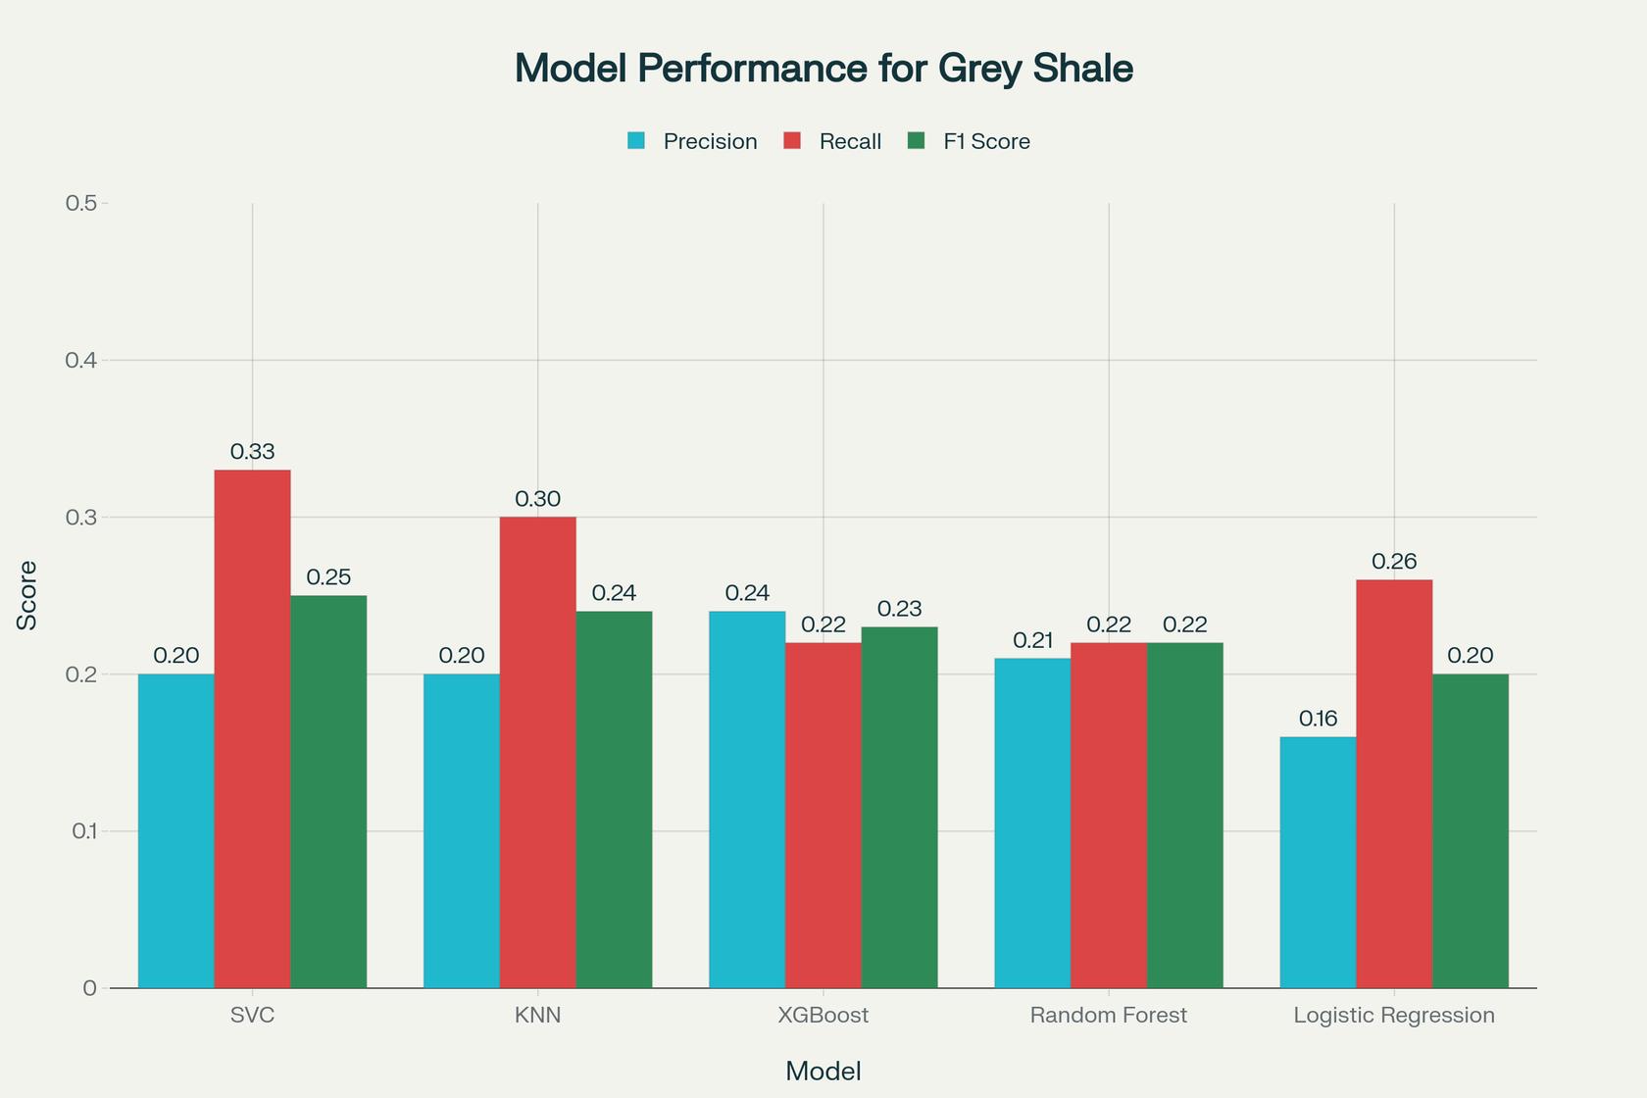
RESULTS

Slide 33
RESULTS
Models | Accuracy
LogisticRegression | 0.57
XGBClassifier | 0.57
RandomForestClassifier | 0.56
SVC | 0.53
KNN | 0.49

Slide 34
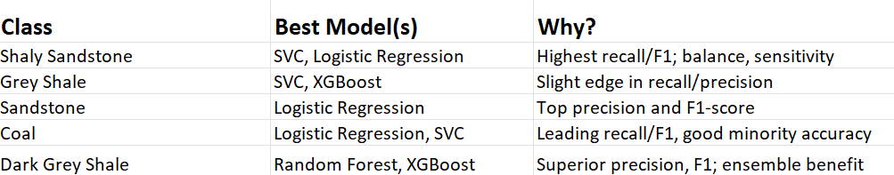
INSIGHTS

Slide 35
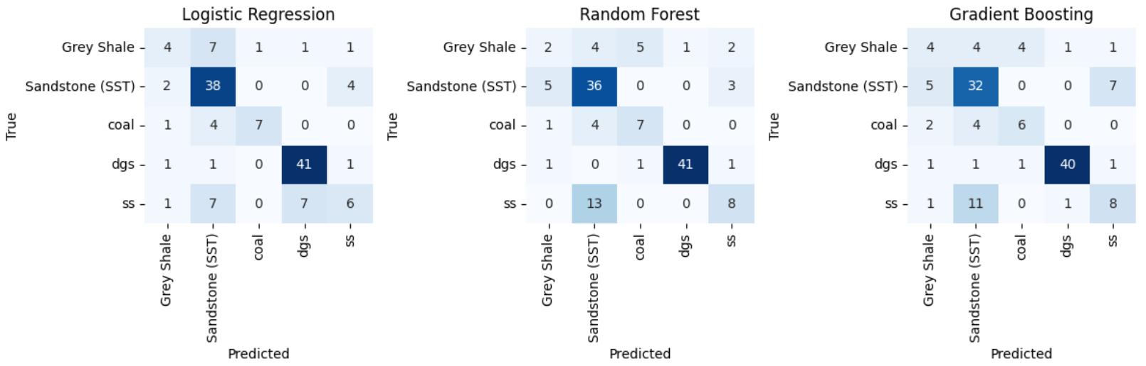
Well 1
Results

Slide 36
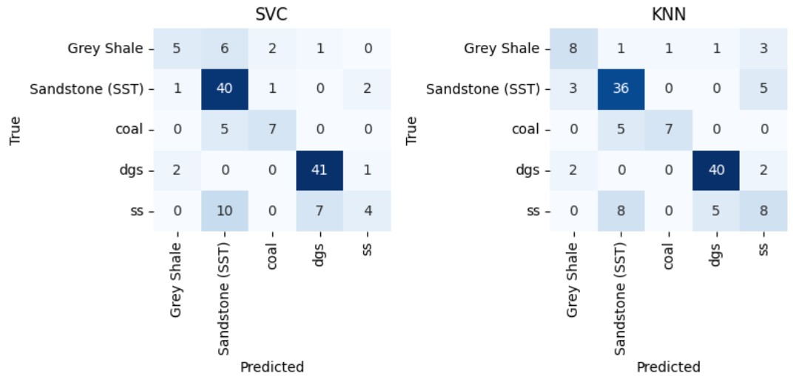
Results

Slide 37
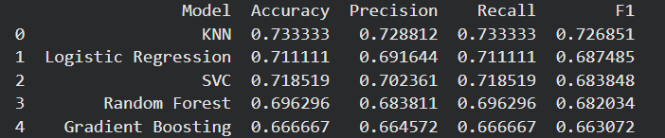
Results

Slide 38
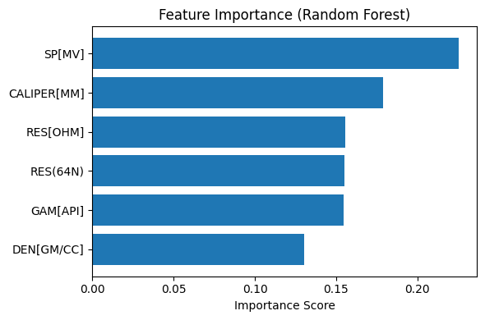

Slide 39
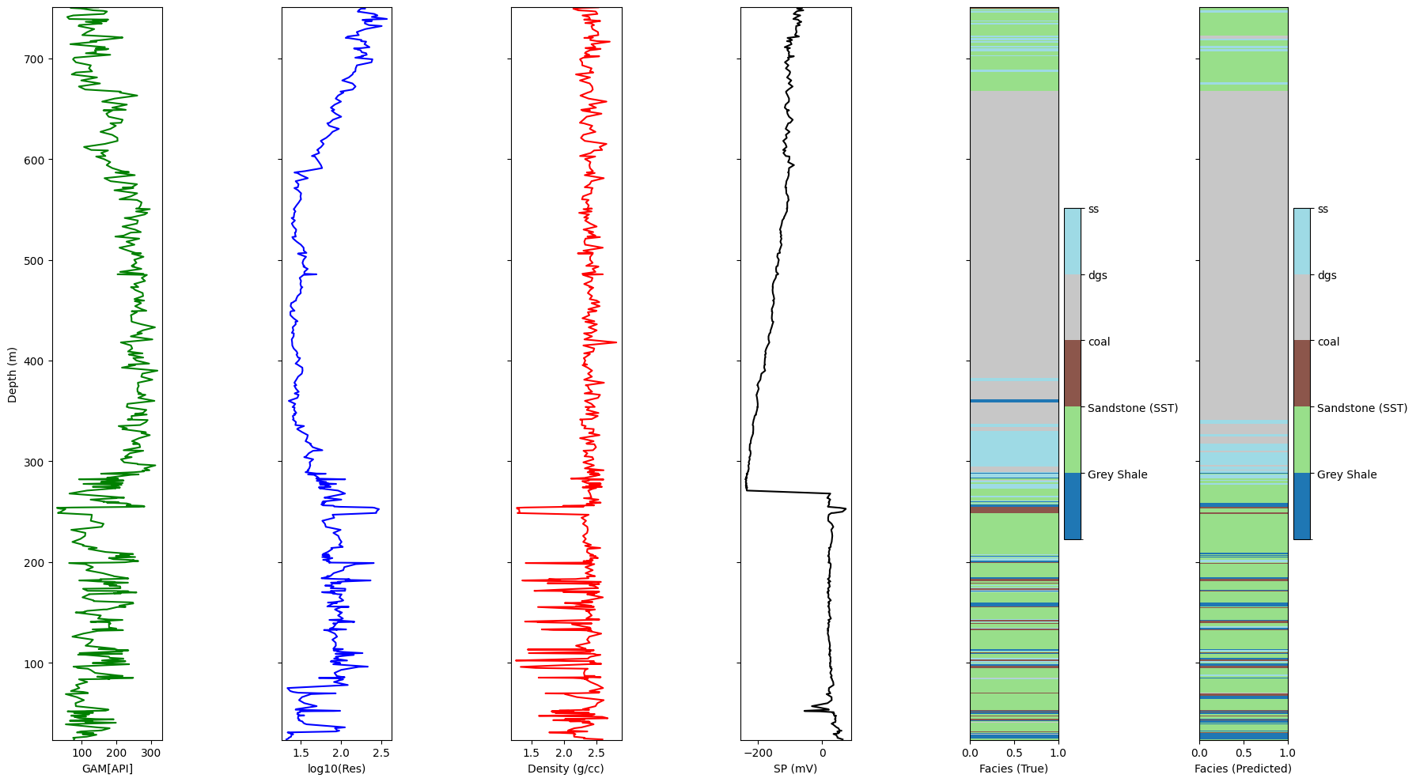
True Facies Vs Predicted Facies

Slide 40
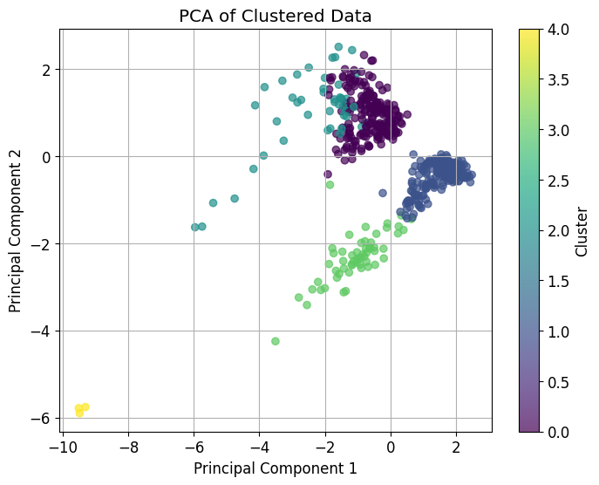
Clustering
Cluster 0: Characterized by relatively high caliper and density, moderate resistivity, and high gamma ray. This cluster might represent shaly or mixed lithologies.
Cluster 1: Shows lower caliper, higher density, lower resistivity, and very high gamma ray. This cluster could correspond to highly shaly intervals.
Cluster 2: Has high caliper, lower density, moderate to high resistivity, and moderate gamma ray. This might indicate porous zones or potentially some sandstone.
Cluster 3: Exhibits very low caliper, high density, very high resistivity, and moderate gamma ray.
Cluster 4: Characterized by moderate caliper, very low density, very high resistivity, and very low gamma ray.

Slide 41
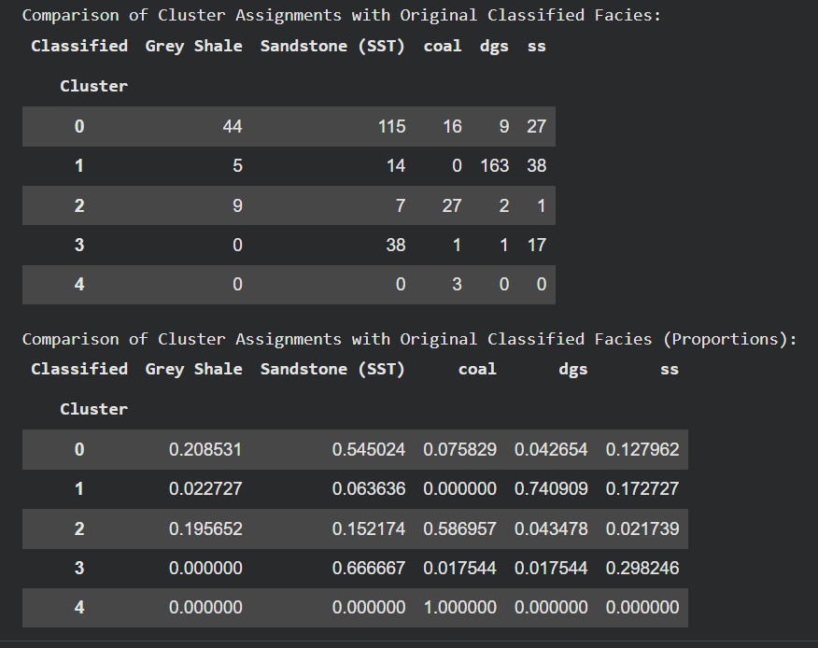
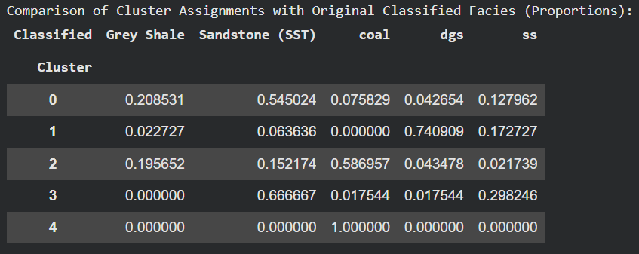
Comparison of Clusters with Original Facies

Slide 42
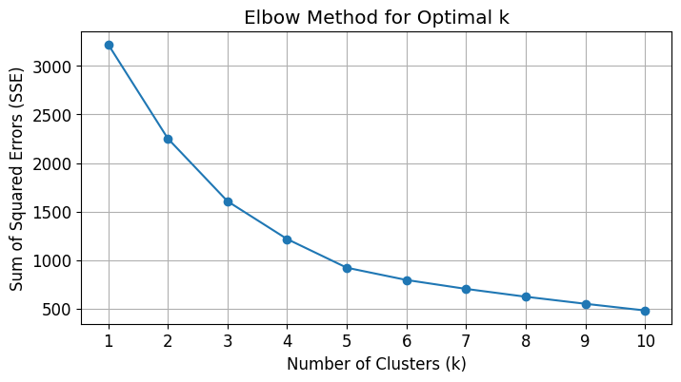

Slide 44
DATA LIMITATIONS & OBSERVATIONS
📉 Limited Dataset:
Only 2,522 data points are available, which may be inadequate for robust model training and generalization.
🧠 Insufficient Feature Set
The current features may not effectively capture the variations required for accurate facies classification.
⚠️ Overlapping Feature Values:
Several data points exhibit very similar feature values but are labeled as different facies, indicating possible issues with data representation or labeling accuracy.

Slide 45
OBJECTIVE -2
Acquiring FE-SEM images and calculating pore characteristics like aspect ratio, porosity from the images.

Slide 46
Materials & Methods
Backscattered Electron (BSE) images were taken for 27 shale samples.
Imaging performed at three magnifications: 150x, 300x, and 1200x
At each magnification, approximately 15–16 images were captured.
Constant parameters maintained during imaging:
Working Distance: 12 mm
Electron Beam Energy: 20 kV

Slide 47
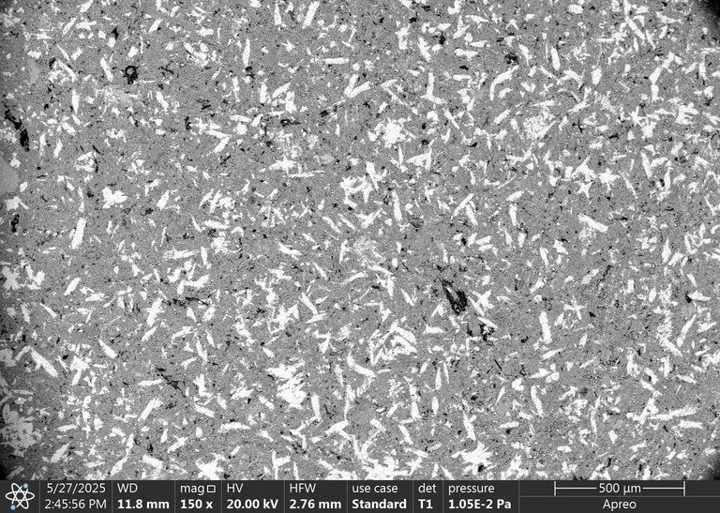
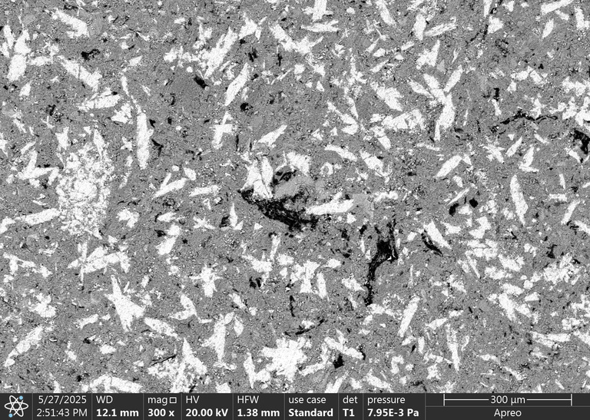
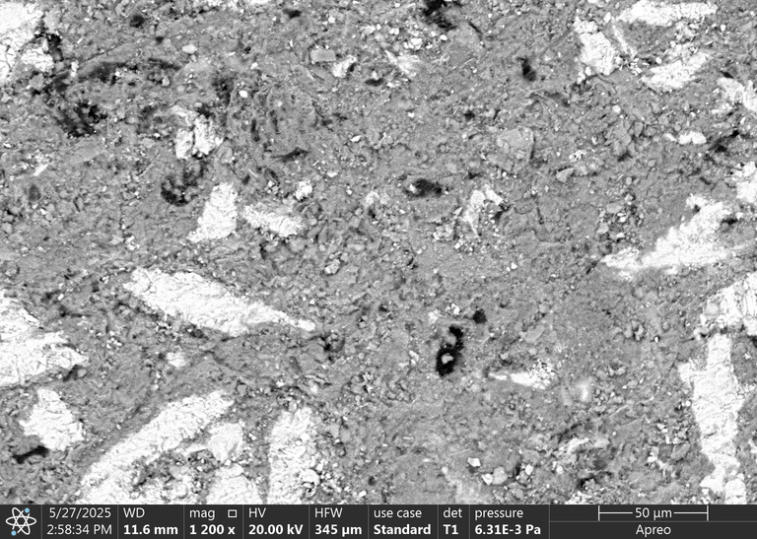
Sample Images
A4

Slide 48

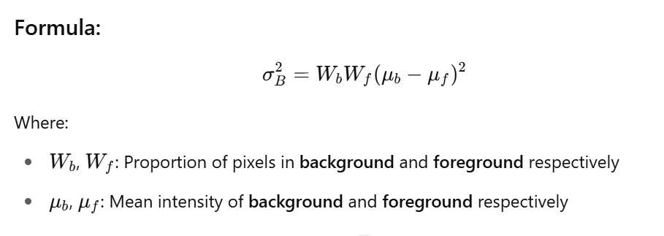


Otsu Thresholding
. It is an algorithm to automatically find the threshold intensity
It works by searching for the threshold intensity that optimally separates the image into two classes the foreground and the background.
this is done by maximizing a metric called the between class variance
Where:
: Proportion of pixels in background and foreground respectively.
: mean intensity of background and foreground respectively

Slide 49
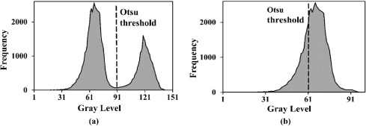
Otsu Thresholding
Limitations:
Foreground and background intensities may overlap, causing poor segmentation.
Does not perform well when:
The image has very dark or very bright regions.
There’s uneven lighting across the image.
Multiple intensity levels exist in the background.

Slide 50
Edge-Threshold Automatic Processing (ETAP) technique
Purpose: Automatic detection and classification of pores in microscopic shale images.
Method:
Uses edge detection to accurately find pore boundaries.
Applies grayscale thresholding to separate pores from surrounding materials.
Combines both approaches for higher accuracy.
Result: Identifies and distinguishes organic and inorganic pores reliably and objectively.

Slide 51
Step 1: Convert Image to 8-bit Grayscale
SEM image is turned into 8-bit grayscale (values from 0 to 255).
Each pixel now has a brightness level, with dark = pore, bright = minerals or solid parts.
Step 2: Analyze Histogram of Pixel Intensities
Count how many pixels exist at each brightness level.
Plot this as a histogram — a graph showing three main peaks:
VP1 = Peak of organic matter
VP2 = Peak of main minerals
VP3 = Peak of bright minerals
Find width (W) of these peaks using Gaussian fitting.

Slide 52
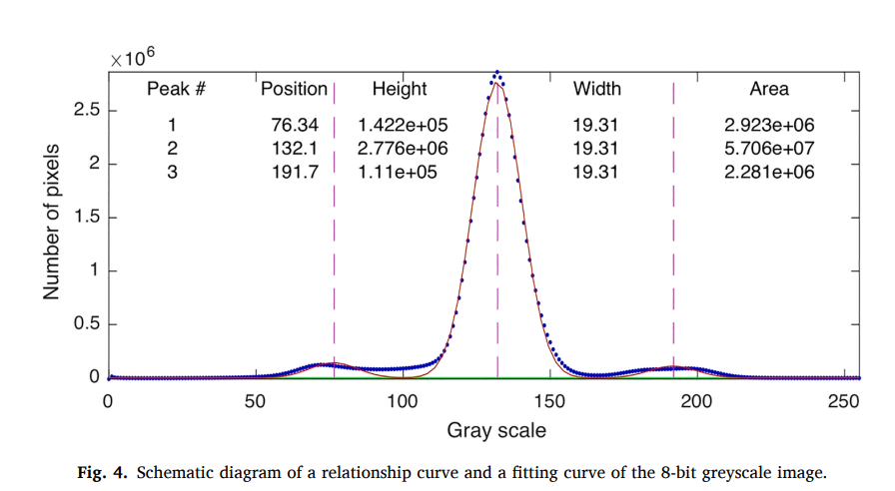

Slide 53
Step 3: Define Cut-Off Points
Pore cut-off (Pcutoff) = VP1 - W
(to segment the darkest areas likely to be pores)
Kerogen cut-off (Kcutoff) = VP2 - W
(to isolate kerogen)
Bright mineral cut-off (Mcutoff) = VP2 + W
(to isolate very bright mineral regions)
Step 4: Segment Initial Images
Segment image using these cut-offs to create:
Initial pore image (darkest parts below Pcutoff)
Initial kerogen-pore image (areas between Pcutoff and Kcutoff)

Slide 54

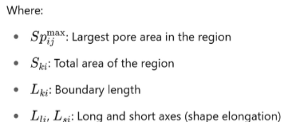
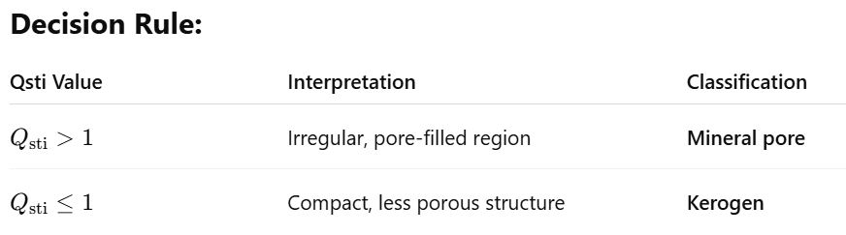
Step 5: Region Classification Using Qsti (Shape–Topology Index)
Qsti is a special shape-based index used to distinguish between:
Kerogen regions (solid, compact organic matter), and
Mineral pores (large, irregular voids)
Qsti Formula:
How It Works:
Numerator measures: how pore-dominated the region is.
Denominator measures: how irregular or elongated the
region is.
The final Qsti value quantifies both shape and content

Slide 55
Step 6: Extract Kerogen Region
Fill and clean up the kerogen regions.
Remove bright minerals from kerogen map using Mcutoff.
Final kerogen map = kerogen area – bright minerals.
Step 7: Edge Detection on Kerogen
Run edge detection on kerogen region to find kerogen pore boundaries
(sharp changes in brightness).

Slide 56
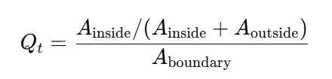
Step 8: Apply Thresholds
Try many brightness thresholds (from 5 to 100).
For each one, compare:
Pixels inside the edge = Ainside
Pixels outside the edge = Aoutside
Calculate a quality score (Qt):
The threshold with highest Qt gives the best pore detection.

Slide 57
Step 9: Combine Both Pore Images
Merge the edge-detected pores with thresholded pores to:
Fill in missing pores missed by edge detection.
Reduce false detections from thresholding alone.
Step 10: Final Result
Combine organic pores (in kerogen) and inorganic pores (in mineral region).
You now have a final segmented image showing both types of pores separately and clearly.
Advantages of ETAP:
More accurate than threshold or edge detection alone.
Automatic and less biased than manual methods.
Clearly distinguishes between organic and inorganic pores.
Useful for pore size distribution, pore volume, and reservoir quality studies.

Slide 58
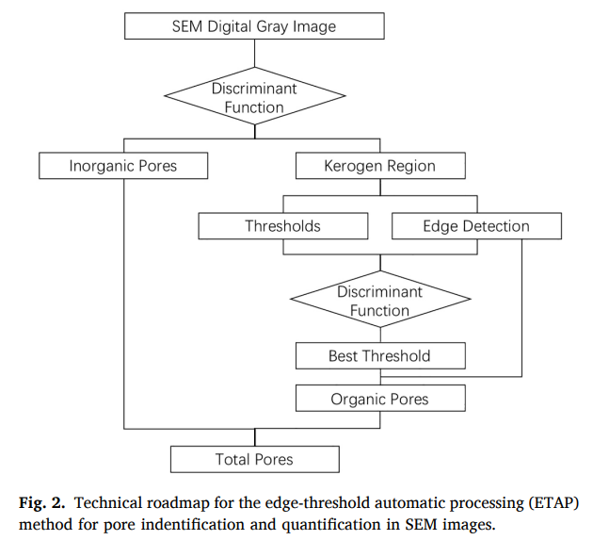
Roadmap for ETAP

Slide 59
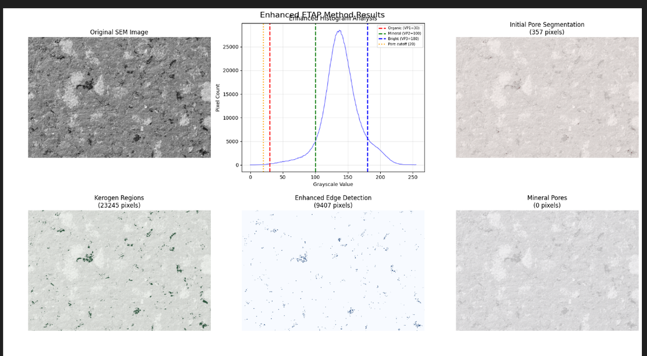
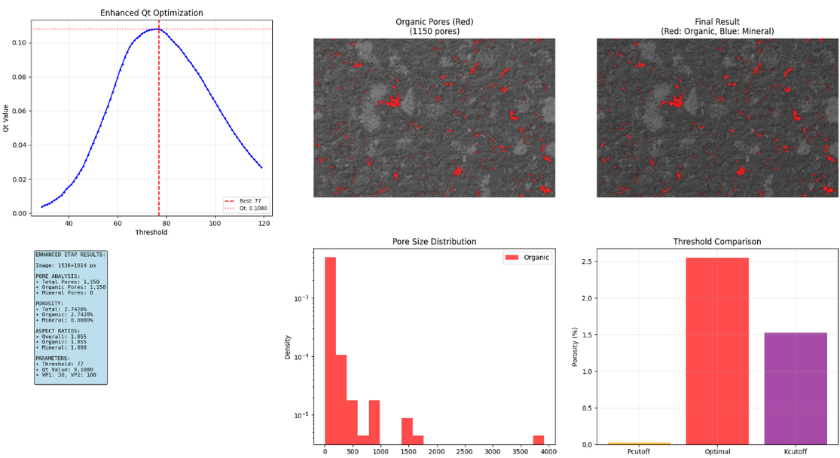
Porosity=2.7428%
Average Pore Aspect = 1.854

Slide 60
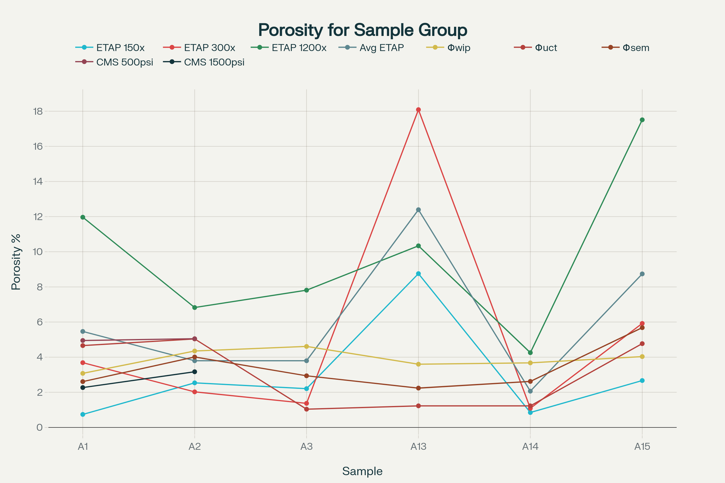

Slide 61
Future Work
Engage with Dr. H. Chris Greenwell, co-author of the ETAP method: Reach out to discuss technical details, focusing on the observed three distinct peaks in their grayscale histogram versus our single/double peaks.
Developing a deep learning model to identify pores in the SEM images

Slide 62
REFERENCES
Hall, B., 2016. Facies classification using machine learning. Lead. Edge 35 (10), https://doi.org/10.1190/tle35100906.1.
https://library.seg.org/doi/pdf/10.1190/tle35100906.1
Babai, Anas Mohamed Abaker, Olugbenga Ajayi Ehinola, and Jing-Hua He. "Clastic facies classification using machine learning-based algorithms: A case study from Rawat Basin, Sudan." Energy Geoscience (2025): 100353. Published by KeAi Communications Co., Ltd
Tian, Shansi, Leon Bowen, Bo Liu, Fang Zeng, Haitao Xue, Valentina Erastova, H. Chris Greenwell, Zhentao Dong, Rixin Zhao, and Jinzhong Liu. 2025. “A Method for Automatic Shale Porosity Quantification Using an Edge-Threshold Automatic Processing (ETAP) Technique.”
1.

Slide 63
THANK YOU

